Slide 1
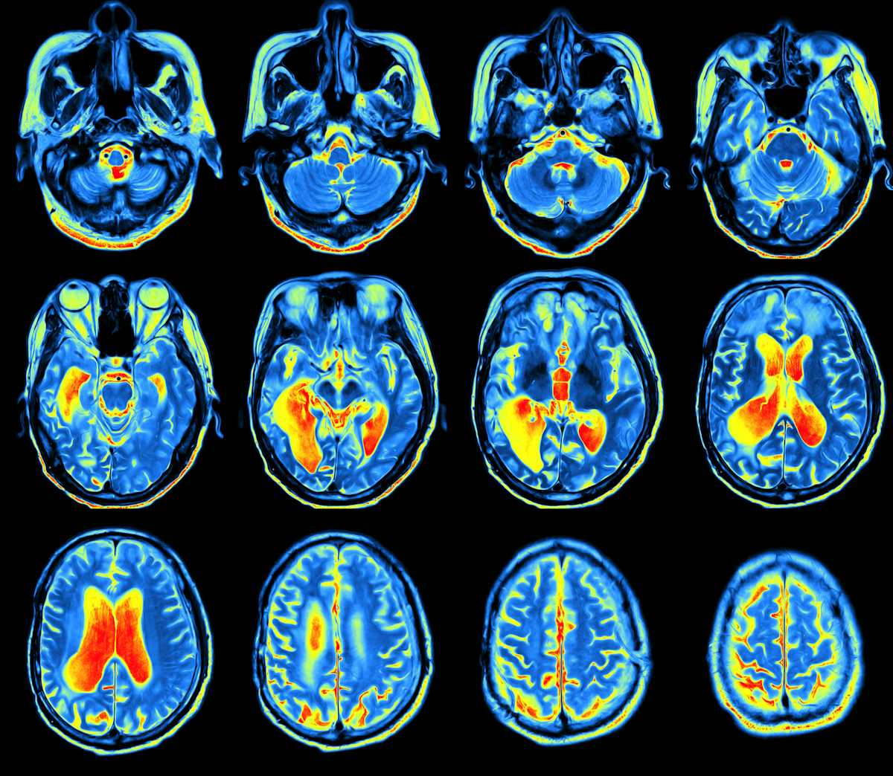
Cross-Architecture Knowledge Distillation Framework with Multi-Scale Geometric Feature Fusion in Medical Image Classification and Segmentation
MD. Shafat Islam Khan
ID - 2121517642 Mahiyat Nawar Mantaqa
ID -2122455042

Slide 2
Figshare Brain Tumor Dataset
Comprehensive MRI Dataset: The Figshare Brain Tumor Dataset contains 3064 T1-weighted contrast-enhanced MRI slices from 233 patients, covering three major tumor types: meningioma, glioma, and pituitary tumor.
Rich Annotation: Each image is annotated with tumor type, patient ID, tumor borders, and binary tumor masks, enabling both classification and segmentation tasks.
Structured in MATLAB Format: Data is stored in .mat files, with structured fields like label, image, tumorBorder, and tumorMask, making it easily accessible for processing and training.
Proven Benchmark: Used in peer-reviewed studies and public GitHub codebases, validating its credibility and relevance for medical image analysis research.

Slide 3
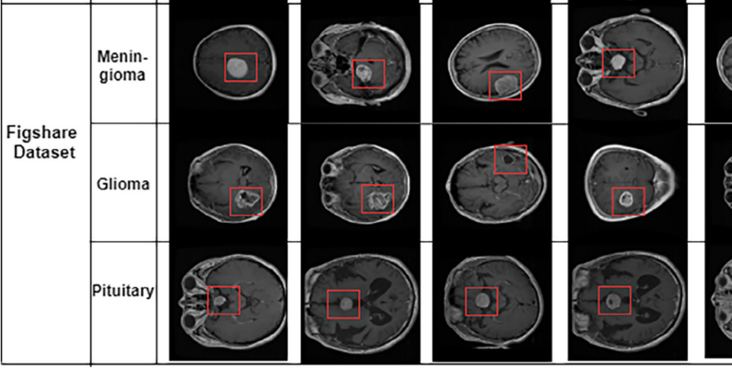

Slide 4
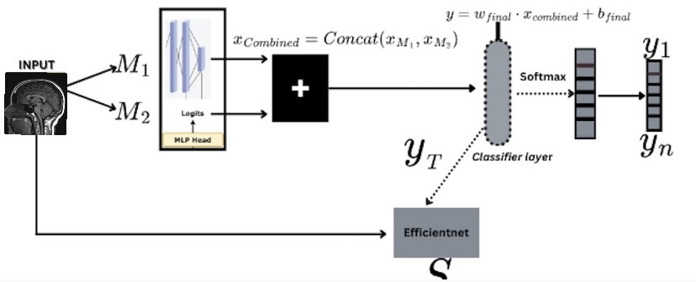
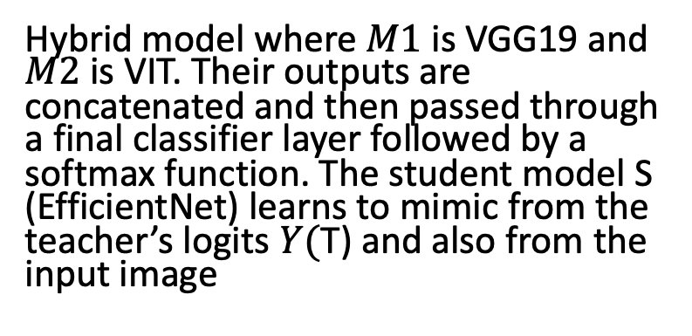
Hybrid model where $M1$ is VGG19 and $M2$ is VIT. Their outputs are concatenated and then passed through a final classifier layer followed by a softmax function. The student model S (EfficientNet) learns to mimic from the teacher’s logits $Y(\text{T}\text{)}$ and also from the input image

Slide 5
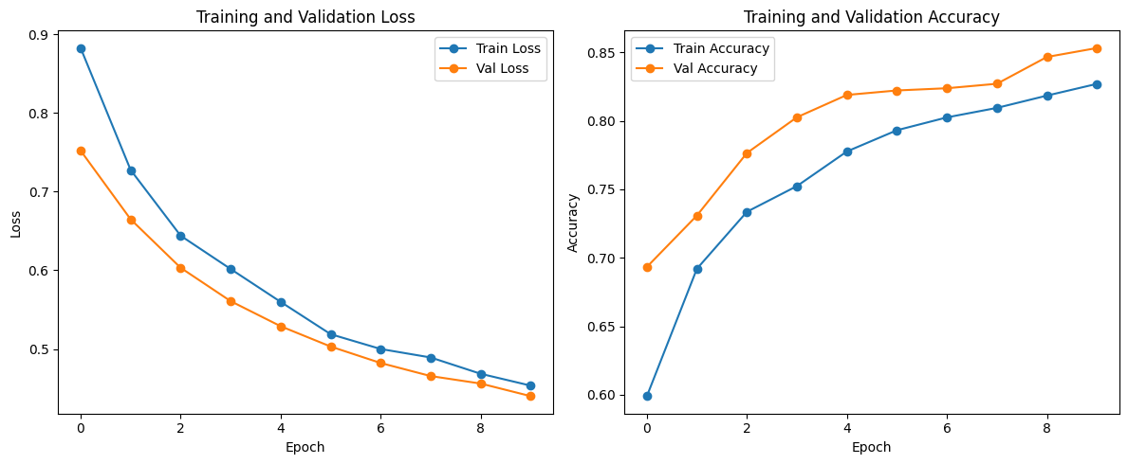
Experiment -1 with Hybrid teacher (VGG19+VIT)
Teacher model
Train accuracy – 0.8270
Validation accuracy – 0.8523
Minimal Data-loss

Slide 6
Student model – Efficientnet B0
Train accuracy – 0.9759
Validation accuracy -0.9364
The student model sucessfully mimics the teahcer infact producing better results.
It was able to do that because The soft targets from the teacher guide the student to learn both texture-based and context-aware representations, smoothing decision boundaries and reducing overfitting.
Code-wise, freezing the pre-trained teacher, concatenating logits, and applying KL-divergence with temperature scaling allowed efficient transfer of both local and global knowledge.

Slide 7
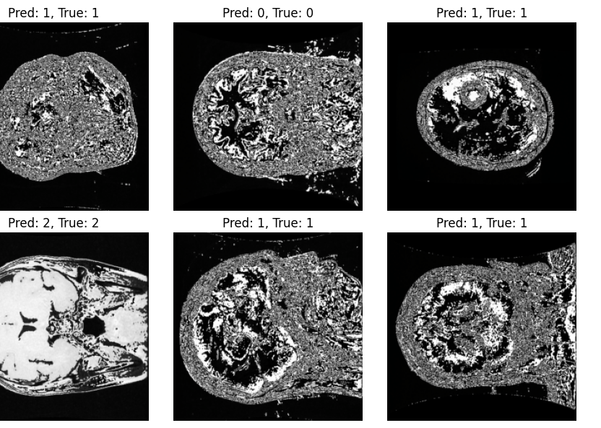
1 is labelled as Meningioma
2 as Glioma
And 3 as Pituitary tumor
Image shows successful classification done by our student model

Slide 8
Similarly we conducted many more experiments to validate why the Cross-Architectural approach is the best
We trained student model with knowledge distillation using 2VGG19’s
We trained the Student model with knowledge distillation using 2VIT’s

Slide 9
Experiment 2- ( VGG19 + VGG19) as teacher
Teacher model
Training accuracy : 0.7793
Validation accuracy : 0.8140
Student model
Training accuracy – 0.9665
Validation acccuracy -0.9217

Slide 10
Experiment 3 - ( VIT + VIT ) as teacher
Teacher model
Validation accuracy – 0.7765
Student model
Training accuracy – 0.9486
Validation accuracy – 0.9125
Training accuracy – 0.7997

Slide 11
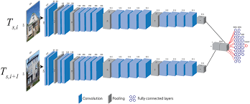
Why did the dual VGG19 did not perfrom ?
While Knowledge Distillation still improved the student relative to the teacher alone, the homogeneous nature of the dual CNN branches led to redundant feature representations
Without global context cues, the distilled student learned strong texture features but lacked broader spatial understanding, resulting in modest gains compared to the hybrid KD.

Slide 12

Why did the dual VIT teacher did not perform well?
The KD process transferred global dependencies effectively, but the absence of convolutional inductive biases limited the student’s ability to capture local features, hence slightly lower performance compared to the hybrid teacher scenario.

Slide 13
Hence (VGG19 + VIT ) as teacher wins
Our hybrid teacher model with VGG19 (CNN) which captures local features and VIT that captures global features enables our student to learn better and display better performance

Slide 14
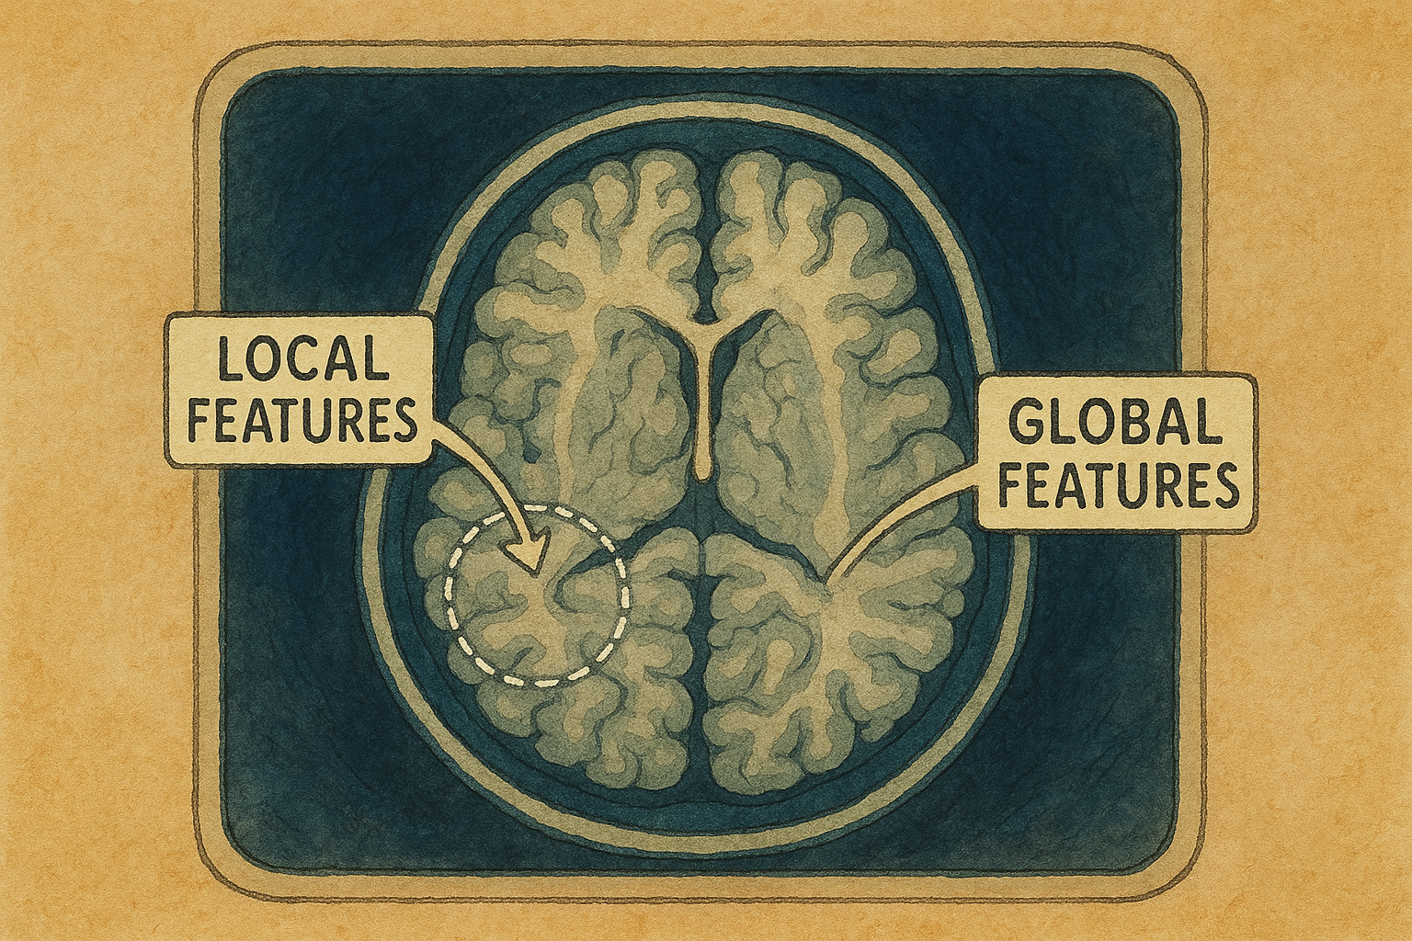
So what are local and global features?
Local features focus on fine-grained, localized information from small regions of the image.
Edges (like the boundary of a tumor)
Texture (how smooth or rough a tissue looks)
Intensity gradients (how brightness changes over small areas
Global features refer to overall patterns or structure across the entire image or volume
Brain symmetry
Global intensity distribution (overall brightness/contrast)
Tumor position relative to the brain

Slide 15

Experiment-4 (Hybrid teacher with Multi-Scaler geometric feature fusion)
Teacher
Training accuracy – 0.8124
Validation accuracy – 0.8238
Student
Training accuracy – 0.9612
Validation accuracy -0.9266

Slide 16
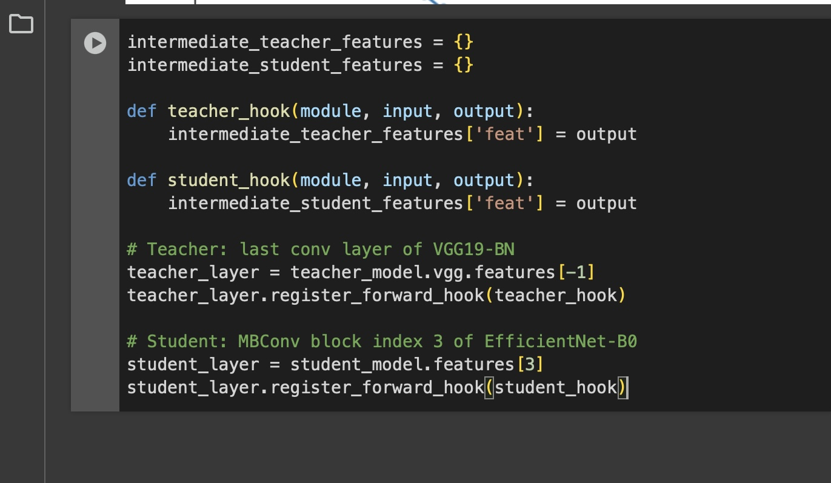
How did we implement MSGFF
Capturing Intermediate Features via Hooks
Every time we do
teacher_model(inputs) or
student_model(inputs)
these hooks stash the raw feature‑maps in …_features['feat']

Slide 17

Whats are hooks?
forward hook is simply a small callback function letting you peek (or even modify) that layer’s activations before they flow on to the next layer

Slide 18
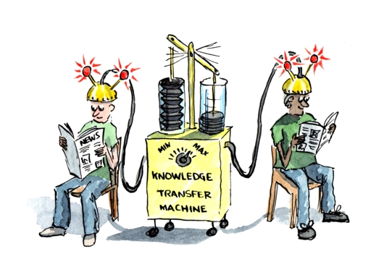
Why do we do it to the last layer of the VGG19?
High‑level semantic features
The very last conv output (vgg.features[-1]) holds the richest spatial patterns—complex tumor shapes, boundaries, etc.—just before the classifier flattens them
Maximizing transfer
Aligning our student to these late‑stage maps encourages it to learn the same high‑level “vision” cues the teacher uses

Slide 19
Why the 3rd MBConv block in EfficientNet‑B0?
1.Comparable semantic depth
Early MBConv blocks (indices 0–2) capture very low‑level patterns (edges, colors).
Very late blocks (indices ≥6) are almost as abstract as the final logits.
Block 3 sits in the mid‑to‑high range—rich enough to encode shapes/textures, but still spatial.
2.Spatial size match
At index 3, EfficientNet’s feature map is still reasonably large matching VGG’s last conv map resolution for meaningful MSE comparisons.
3.Practical balance
It’s a “sweet spot” where both teacher and student have similar map sizes and semantic content, making the multi‑scale fusion loss stable.

Slide 20
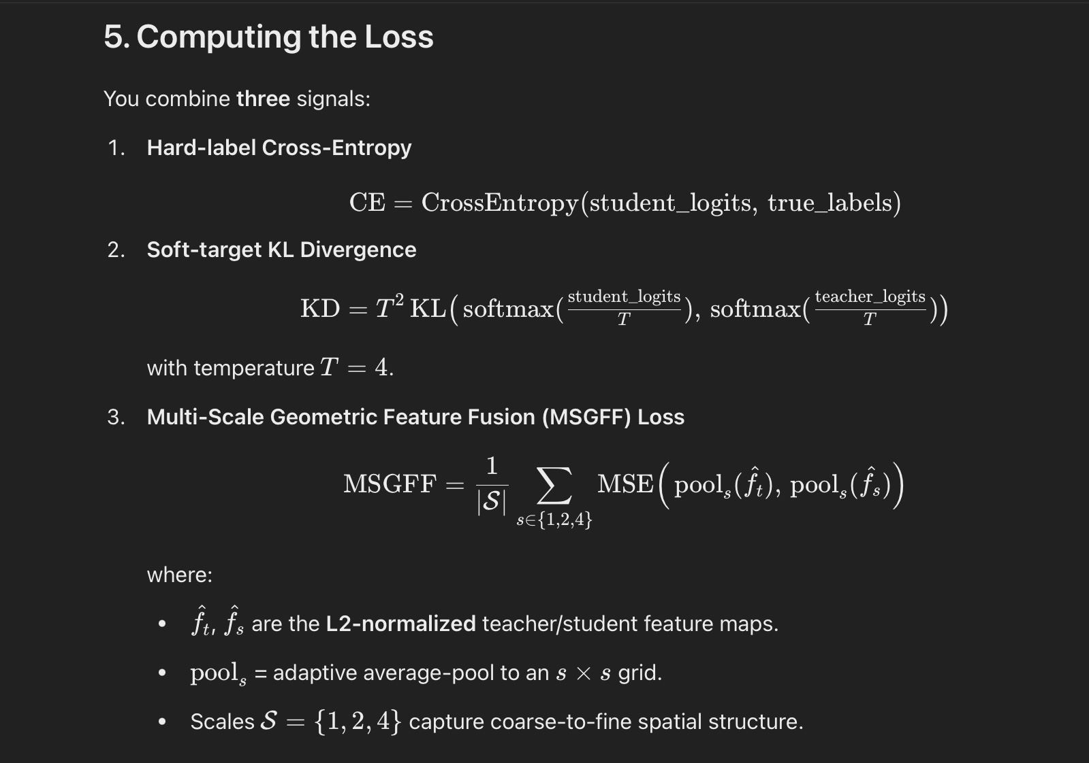
Now we put them together and feed the maps to our Multi-scaler Geometric feature fusion loss
Multi-Scale Analysis: The extracted feature maps are processed at multiple scales to capture both coarse and fine-grained information. This is achieved by applying adaptive average pooling operations to resize the feature maps to various dimensions (e.g., 1×1, 2×2, 4×4).​ We combine all these and compute total loss in the training loop
Hard Labels (Cross-Entropy): Ensure that the student model learns to make accurate predictions aligned with the true class assignments.​
Soft Labels (KL Divergence): Encourage the student model to mimic the teacher's output distribution, capturing the teacher's learned inter-class relationships and nuances

Slide 21
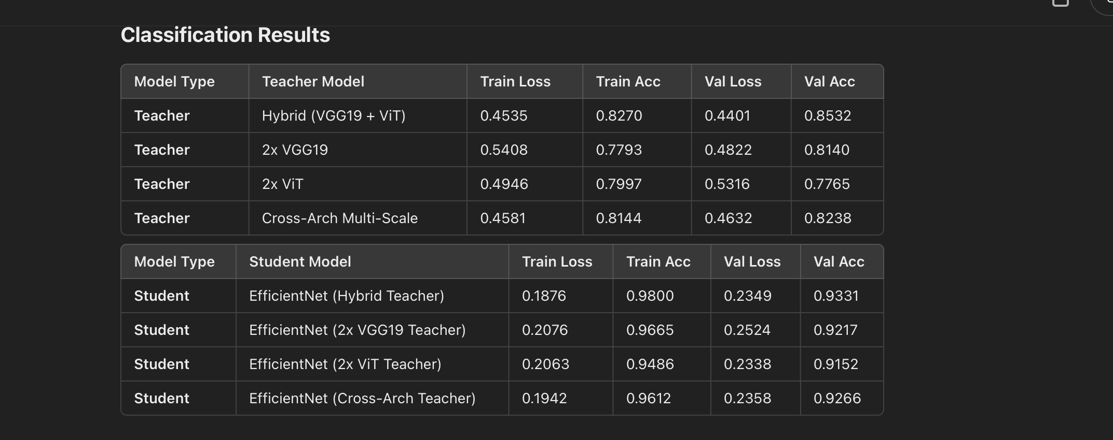
Summary of classification results

Slide 22
Why are all our results so similar?
The dataset is small
Strong student EfficientNet-B0 is known for its efficiency and representational strength—it may already be near the performance ceiling for this task
Even with hybrid or ensemble setups, the core representations (texture in CNNs, attention in ViTs) overlap significantly at the output level when distilled through logits.
Hence, student receives similar supervision regardless of teacher variant, leading to similar accuracy.
KD Loss Dominance & Hyperparameter Stability
Our KD loss mixes CE + KL with weights (e.g., α=0.1, T=4). These fixed values likely stabilize training, reducing variance across experiments.
Combined with the fact that you froze all teacher layers, there’s limited dynamic variation that could cause significant shifts in performance.

Slide 23
Now let’s discuss the final part which is the segmentation

Slide 24
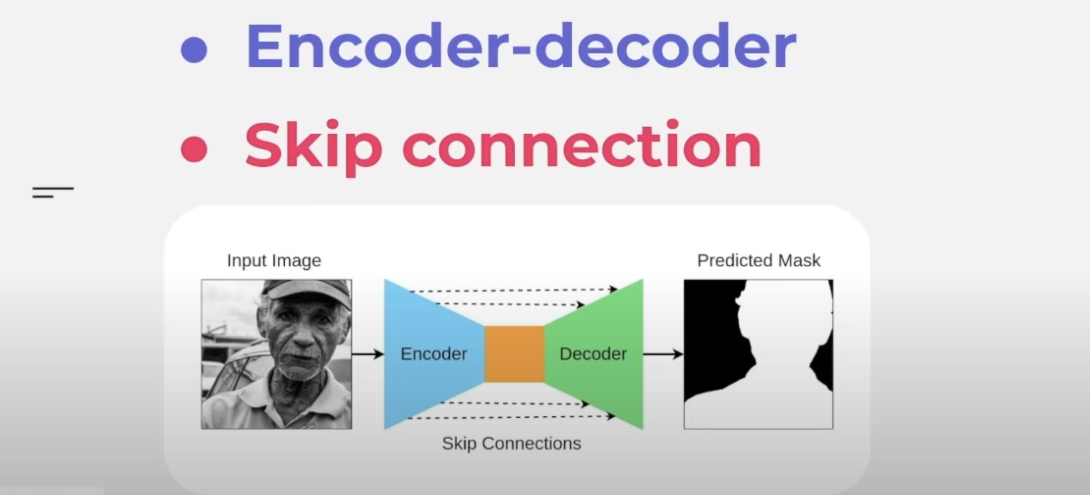
We have used (U-net + VIT) for segmentation
Contracting Path (Encoder): Extracts hierarchical features using repeated convolutions and pooling, reducing spatial dimensions while increasing semantic abstraction.
Expanding Path (Decoder): Upsamples the compressed feature maps to recover spatial resolution, often using transposed convolutions or bilinear upsampling.
Skip Connections: Directly passing high-resolution features from the encoder to the corresponding decoder layers, preserving fine-grained details for accurate segmentation.

Slide 25
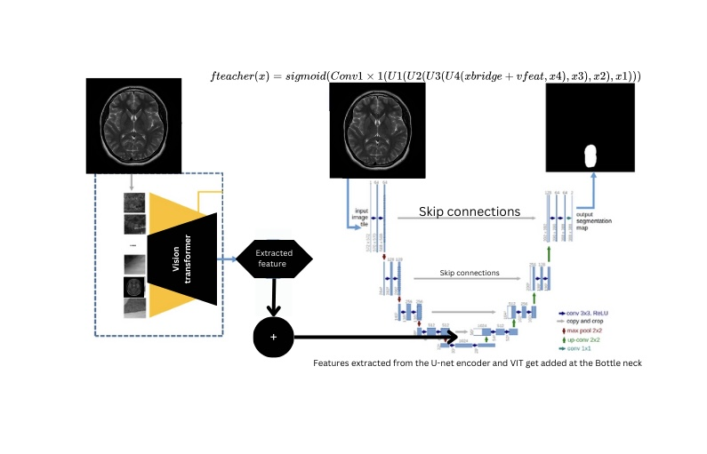

Slide 26

For student we use a smaller U-net
The student model is defined as a simpler U-Net in the StudentUNet class. It is designed to have fewer parameters and lower computational cost compared to the teacher.
1
Similar to the teacher, the encoder is composed of sequential DoubleConv blocks and pooling layers. However, the channel dimensions are reduced (starting with 32 channels, then 64, 128, and 256) compared to the teacher’s larger channel dimensions.
2

Slide 27
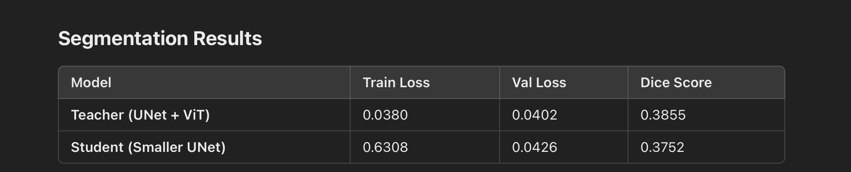
Initial results

Slide 28
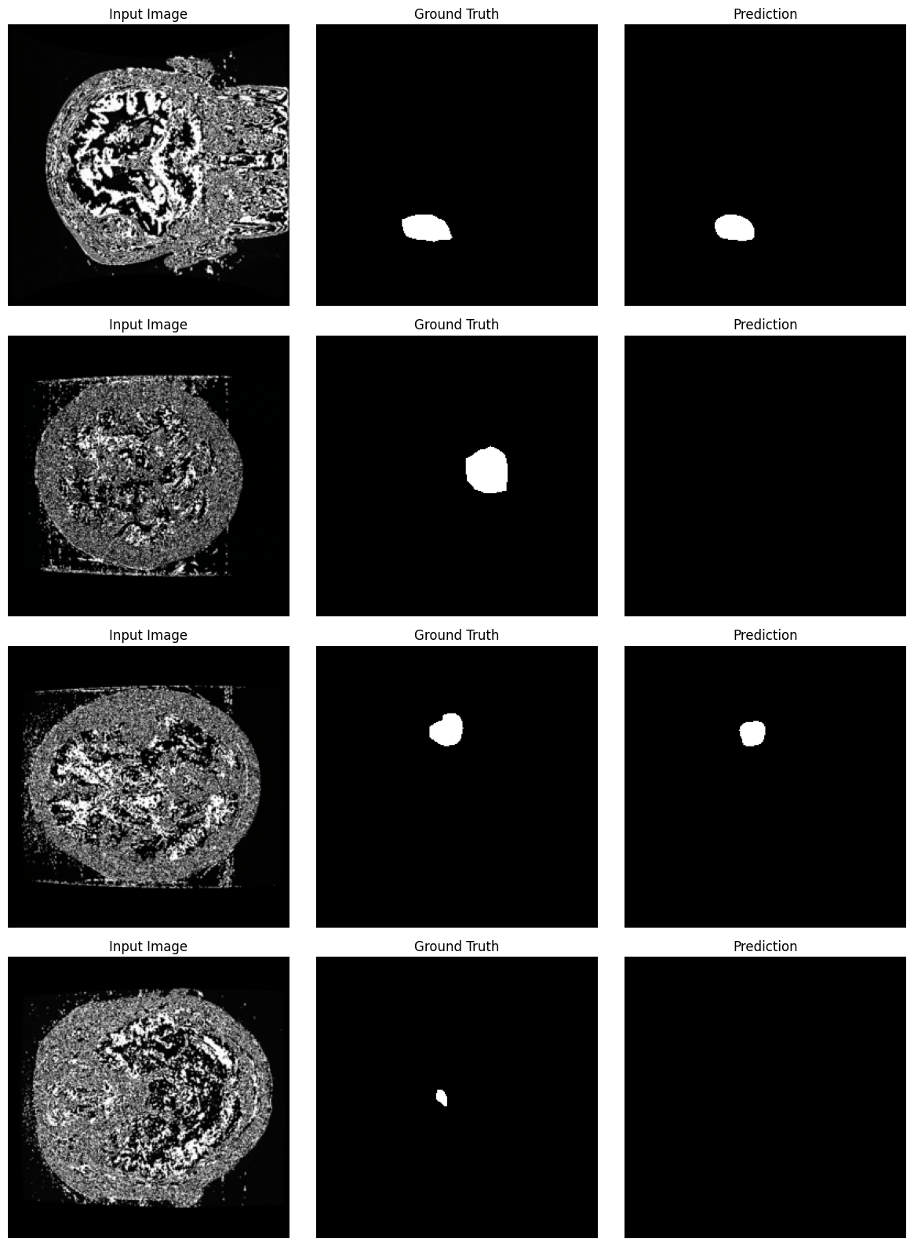

Slide 29
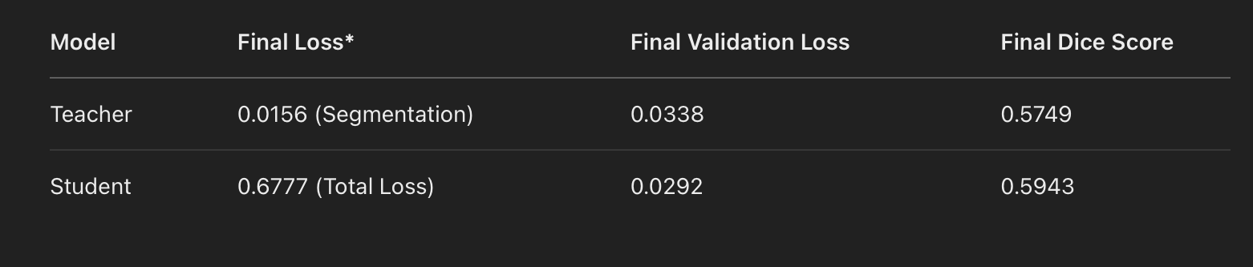
After fine-tuning

Slide 30
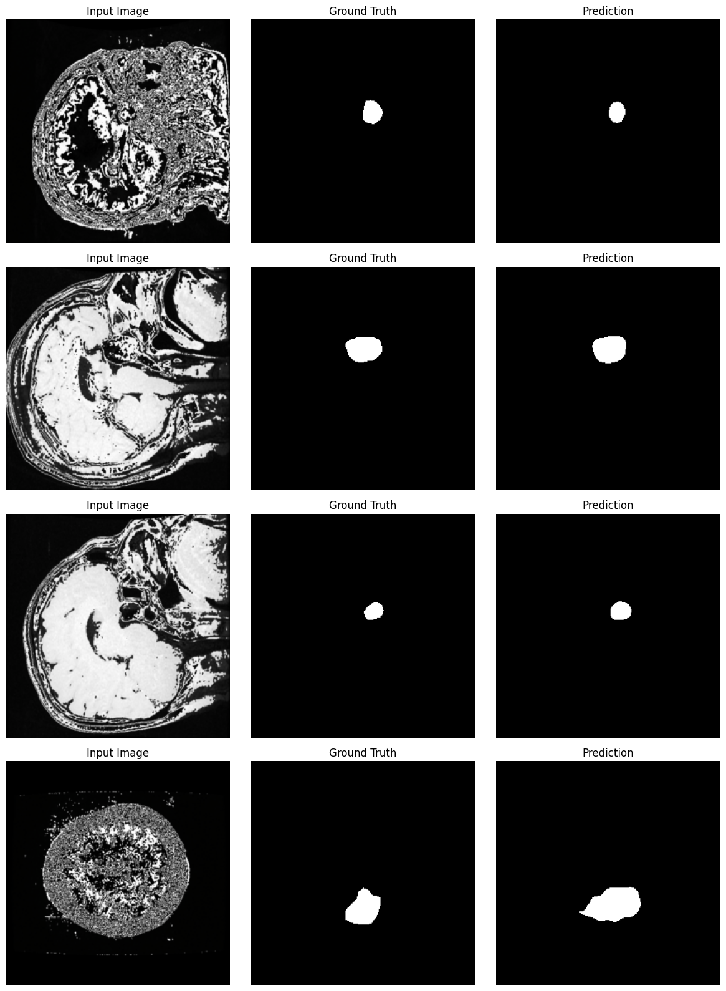

Slide 31
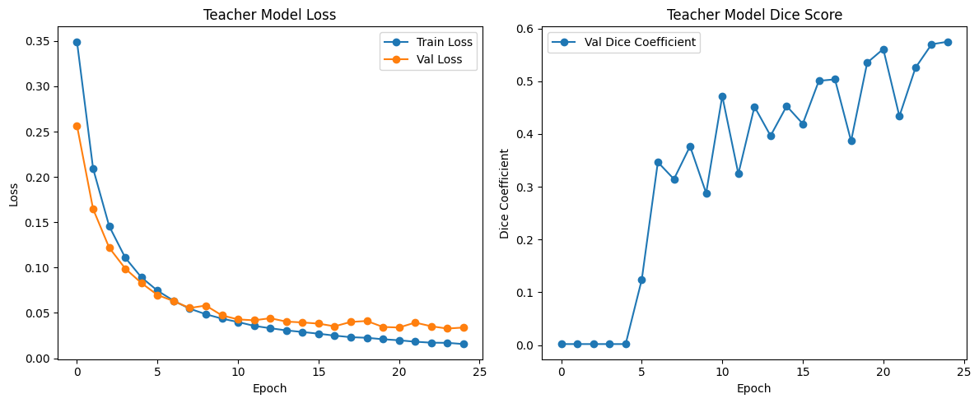

Slide 32
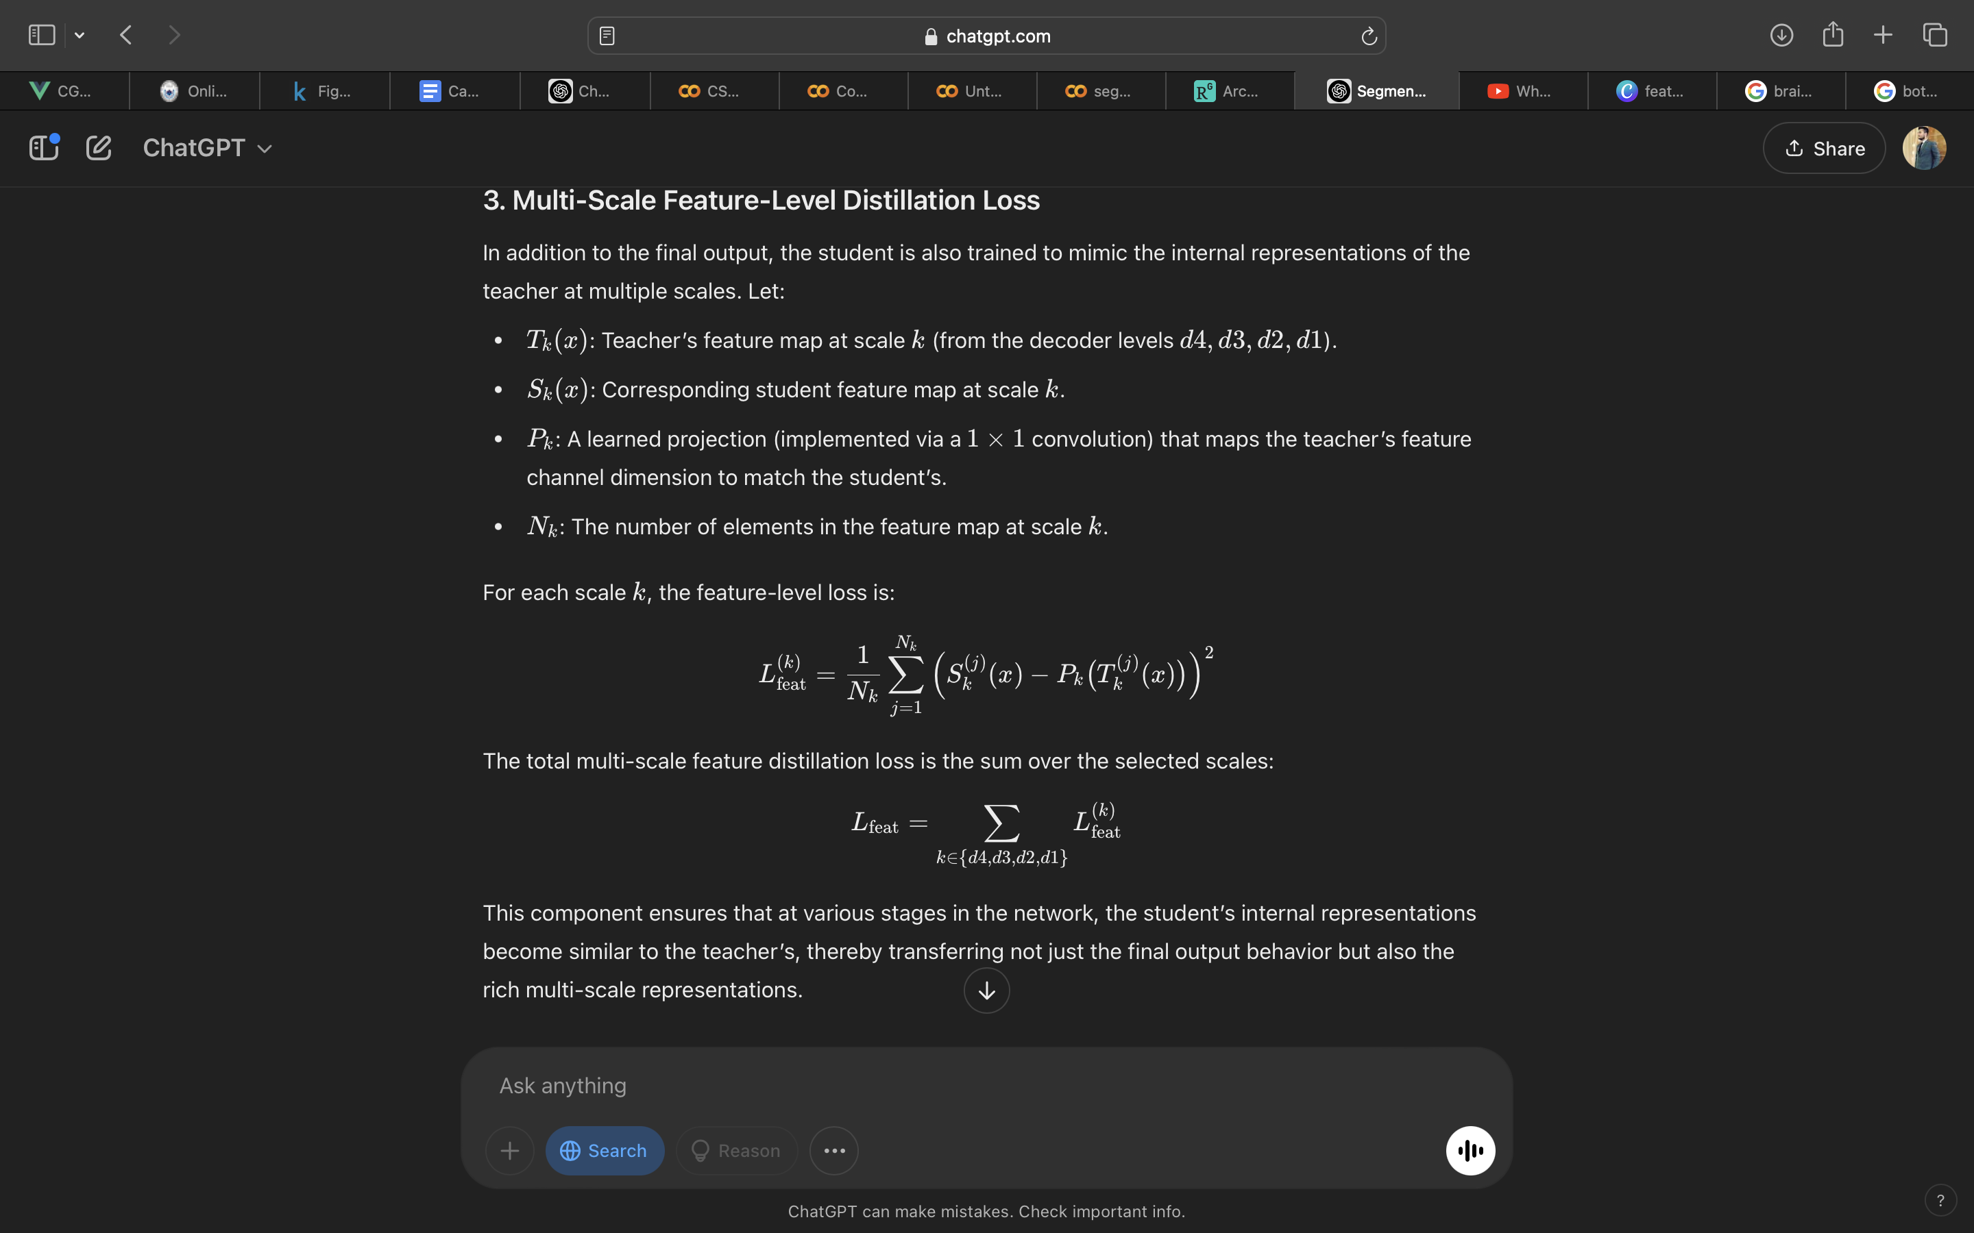
How did we achieve better results?
Multi-Scale Feature-Level Distillation Loss:
For each corresponding decoder level (d4, d3, d2, d1), the teacher’s features (after projection) are compared to the student’s features using MSE loss.
This encourages the student to match the teacher’s internal representations at different scales.
Weighted by a hyperparameter gamma.

Slide 33
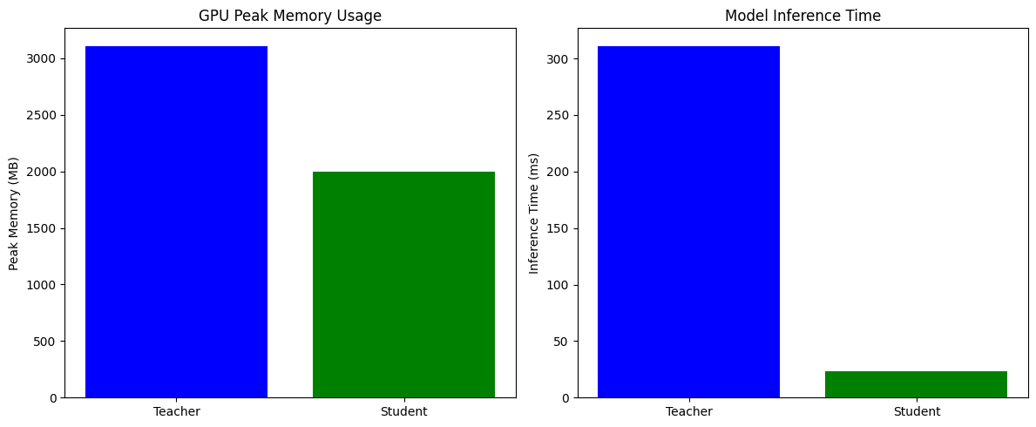
COMPARISON
Where other paper related to our work might have achieved higher accuraccy but the computational cost was significantly higher
We sucesfully made our lighter weight model perform better than our teacher model

Slide 34


